Slide 1
Investigation of IMDB Movie Scores
Adam Forestier, Parika Gupta, Brandon Jones, Nathaniel Williams

Slide 2
Team Contributions
Adam: Did majority of coding aspect of the project, came up with theories to model, wrote analyses, and organized the project
Nathaniel - Created geo map visualization and decision tree predictive model, came up with theories to model, and wrote majority of analyses
Brandon - Assisted with debugging of code, wrote many analyses, and helped come up with project idea
Parika - Provided feedback on work, made suggestions for data investigation

Slide 3
Background
The primary goal of our project was to build predictive models to estimate IMDB movie scores
Being able to determine whether or not a movie will be a quality release without critic ratings could address a number of business problems that surround the financing and marketing strategies for different types of movies
Film studios could use these insights to focus their budget on the keys to a movie’s success, increasing the company’s revenue and company value

Slide 4
Data Collection and Modification
Our data was retrieved from Kaggle as a CSV file
Due to duplications causing skew in results, we eliminated movies that had the exact same movie title, release year, and director (Could not simply eliminate by title as movies are regularly remade or may otherwise share the same title)
We created new variables from the existing data that we believed would help with our predictions
Our final step before beginning our visual analysis was to remove unnecessary characters and whitespace and convert binary categorical variables to “1’s and and 0’s”

Slide 5
Data Analyses and Results - Visualizations
We created many different charts to visualize data, but we will only be showing a handful due to time constraints
We also commonly used the “plotly” package. This package makes the visualizations interactive in the RMarkdown file and when knitted to HTML documents, but unfortunately the charts had to saved as PNG files to include in slides, so they will not be interactive

Slide 6
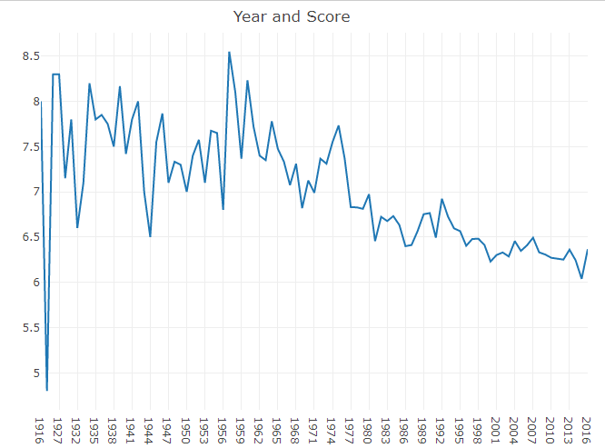
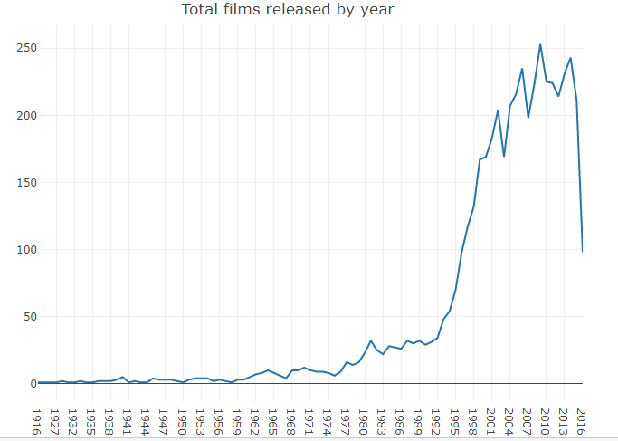
Data Analyses and Results - Visualizations
The first two visualizations we are showing is average movie movie score by year and total movies in the data set that year
The older years may have biased average scores, because there are so few entries included in the data set for that year.

Slide 7
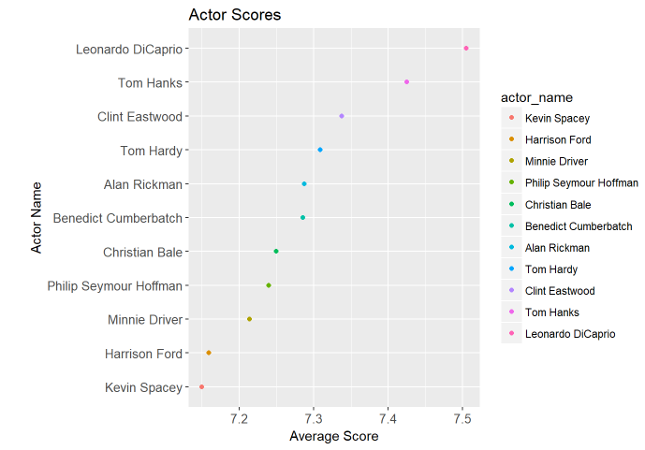
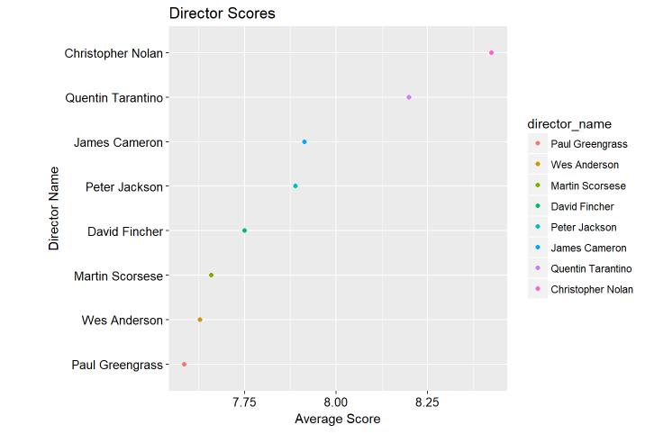
Data Analyses and Results - Visualizations
The following two charts we are showing is highest average scoring actors and directors who have at least 7 movies in the data set to avoid bias
These two visualizations were key as we made new variables that were binary categorical factors of each name and used these variables in our predictive models

Slide 8
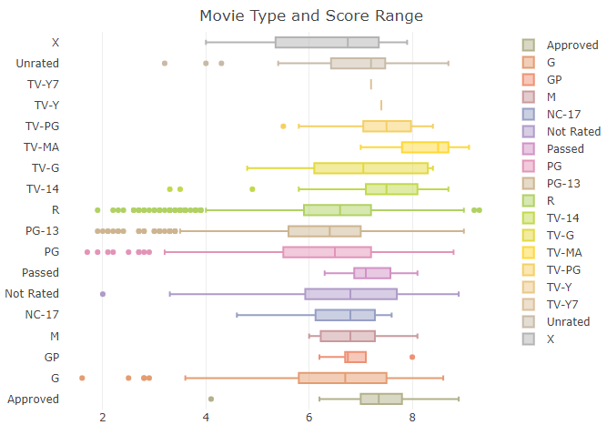
Data Analyses and Results - Visualizations
The multi-boxplot visualization below shows the score range of movies by their content ratings

Slide 9
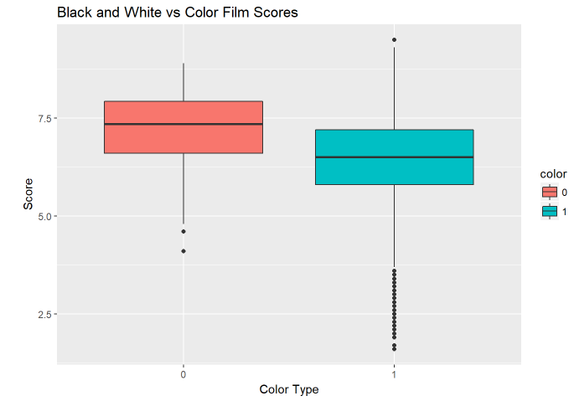
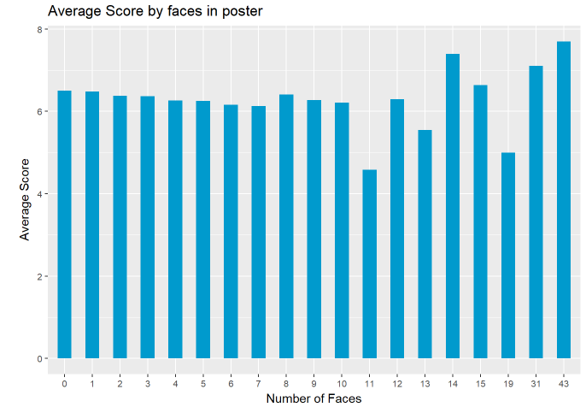
Data Analyses and Results - Visualizations
The side-by-side boxplot shows whether color or black-and-white films tend to score better
The column chart shows if number of faces in movie posters has a positive or negative effect on average scores

Slide 10
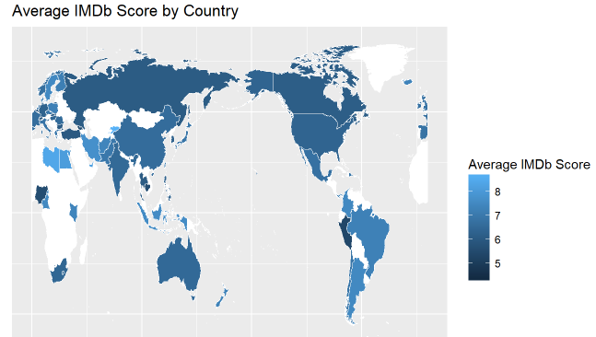
Data Analyses and Results - Visualizations
The final visualization we will be sharing with you is our geo map of average film score by nation
Some nations were biased as they had many less entries in the data set compared to their counterparts

Slide 11
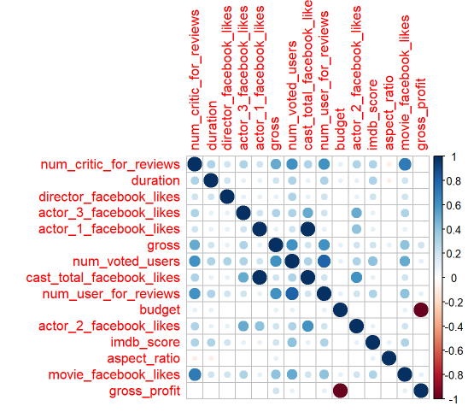
Data Analyses and Results - Correlation
We created a data frame including only numerics to see how numeric type variables correlated with each other. We then constructed a correlation table using circles to display correlation. Size and shade of the circle indicates the strength of the relationship

Slide 12
Data Analyses and Results - Predictive Models
Used a 10-fold cross validated configuration of control for each model
Each model was used to predict IMDb Scores based on:
Country
Film color (b&w or in color)
Content rating
Release year
Number of faces in the movie poster
Gross revenue
The presence of various top-performing actors and directors
Models Trained:
Multiple linear regression
Gradient boosted machine
Support vector machine
Decision tree

Slide 13
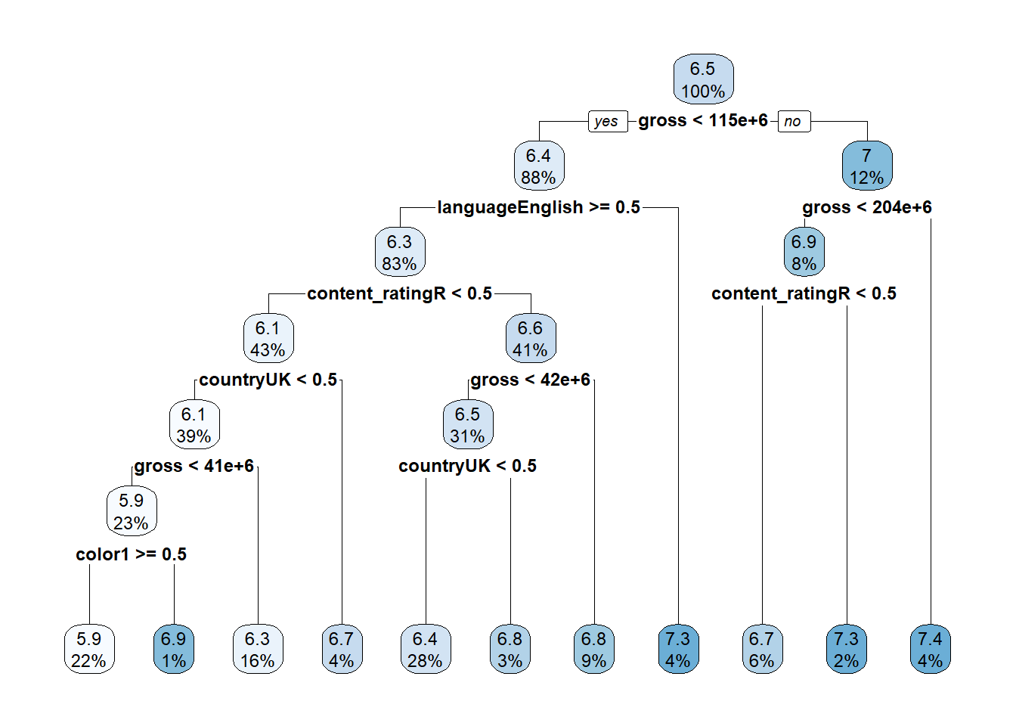
Data Analyses and Results - Predictive Models
The final decision tree model:
Notes:
A decision tree isn’t a black box model.
The decision tree can give better actionable steps to improve the IMDb rating for a film to be released in the future. In general, movies that are released in the UK, aren’t produced in color, are rated R, and aren’t in English tend to have higher IMDb scores. Movies with a higher gross tend to have the highest IMDb scores. It may be recommended to consider any of these factors for a film producer who wants to improve their movie’s critical response.

Slide 14
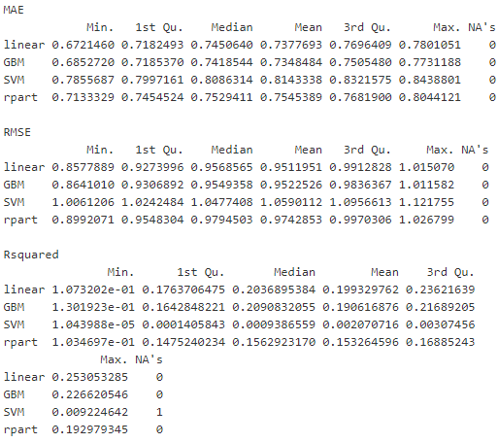
Data Analyses and Results - Predictive Models
The Linear Model with a 10-fold cross validation has the best performance. It had the lowest RMSE and the highest R².

Slide 15
Conclusion
Key Findings:
Movies with higher gross revenue tend to have higher IMDb scores, on average.
The amount of films released each year has gone up drastically over the last century, but the average IMDb score for films has steadily declined over the years.
Project was limited by the quality of the data that could be extracted from IMDb’s API
Many missing or duplicate values and differences in the currencies reported

Slide 16
Open Floor

